Slide 1
Two-Dimensional Conduction:
Finite-Difference Equations and
Solutions
Chapter 4
Sections 4.4 and 4.5

Slide 2
Finite-Difference Method
The Finite-Difference Method
An approximate method for determining temperatures at discrete
(nodal) points of the physical system.
Procedure:
Represent the physical system by a nodal network.
Use the energy balance method to obtain a finite-difference
equation for each node of unknown temperature.
Solve the resulting set of algebraic equations for the unknown
nodal temperatures.

Slide 3
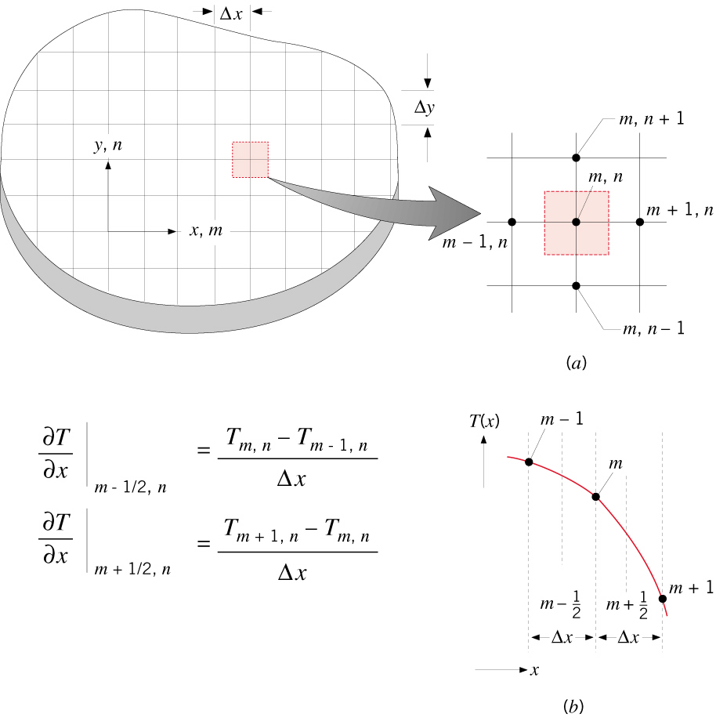
Finite-Difference Approximation
The Nodal Network and Finite-Difference Approximation
The nodal network identifies discrete
points at which the temperature is
to be determined and uses an
m,n notation to designate their location.
What is represented by the temperature determined at a nodal point,
as for example, T_{m,n}?
A finite-difference approximation
is used to represent temperature
gradients in the domain.
How is the accuracy of the solution affected by construction of the nodal
network?
What are the trade-offs between selection of a fine or a coarse mesh?

Slide 4

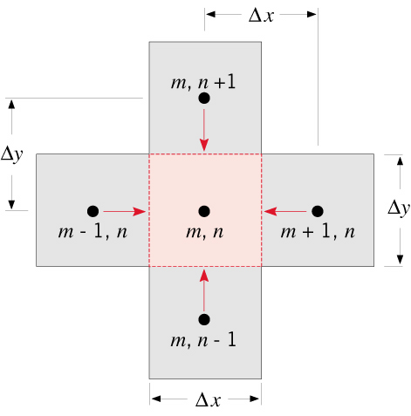
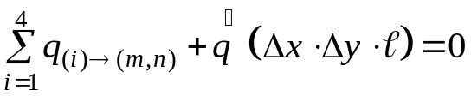
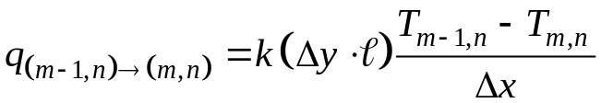
Energy Balance Method
Derivation of the Finite-Difference Equations
- The Energy Balance Method -
As a convenience that obviates the need to predetermine the direction of heat
flow, assume all heat flows are into the nodal region of interest, and express all
heat rates accordingly.
Hence, the energy balance becomes:
(4.34)
Consider application to an interior nodal point (one that exchanges heat by
conduction with four, equidistant nodal points):
where, for example,
(4.35)
Is it possible for all heat flows to be into the m,n nodal region?
What feature of the analysis insures a correct form of the energy balance
equation despite the assumption of conditions that are not realizable?

Slide 5
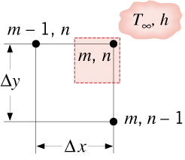
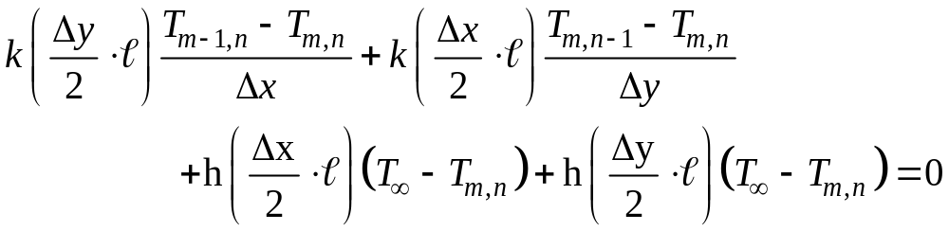

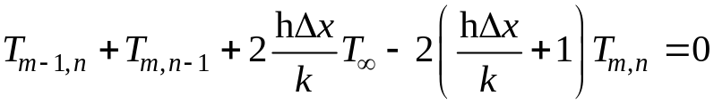
Energy Balance Method (cont.)
A summary of finite-difference equations for common nodal regions is provided
in Table 4.2.
Consider an external corner with convection heat transfer.
or, with ,
(4.47)

Slide 6
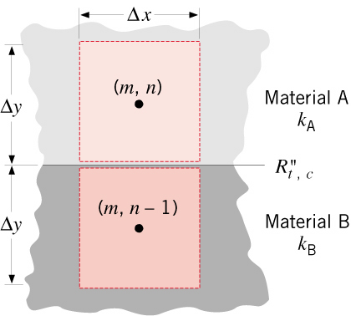
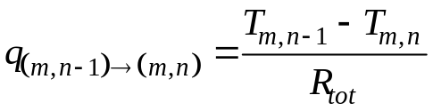
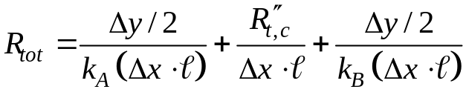
Energy Balance Method (cont.)
Note potential utility of using thermal resistance concepts to express rate
equations. E.g., conduction between adjoining dissimilar materials with
an interfacial contact resistance.
(4.50)

Slide 7


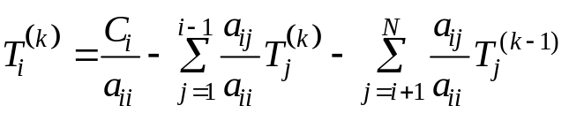

Solution Methods
Solutions Methods
Matrix Inversion: Expression of system of N finite-difference equations for
N unknown nodal temperatures as:
(4.52)
Coefficient
Matrix (NxN)
Solution Vector
(T₁,T₂, …T_{N})
Right-hand Side Vector of Constants
(C₁,C₂…C_{N})
Solution
Inverse of Coefficient Matrix
(4.53)
Gauss-Seidel Iteration: Each finite-difference equation is written in explicit
form, such that its unknown nodal temperature appears alone on the left-
hand side:
(4.55)
where i =1, 2,…, N and k is the level of iteration.
Iteration proceeds until satisfactory convergence is achieved for all nodes:
What measures may be taken to insure that the results of a finite-difference
solution provide an accurate prediction of the temperature field?

Slide 8
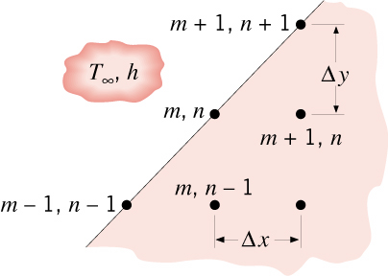
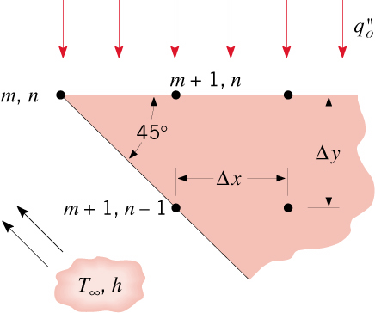
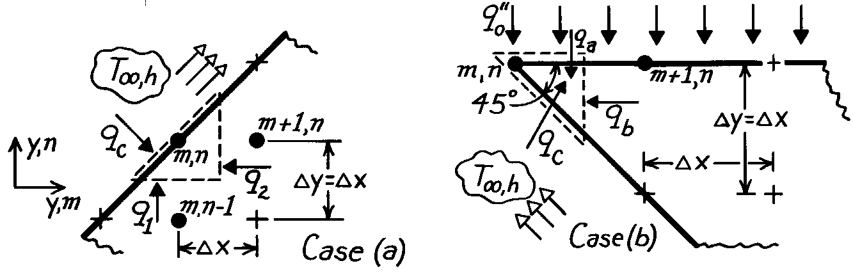
Problem: Finite-Difference Equations
Problem 4.41: Finite-difference equations for (a) nodal point on a diagonal
surface and (b) tip of a cutting tool.
(a) Diagonal surface
(b) Cutting tool.
Schematic:

Slide 9


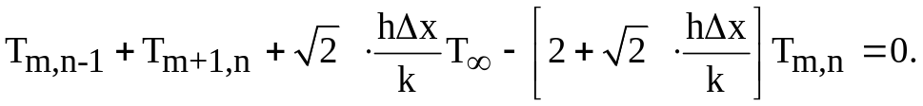
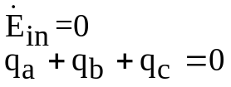
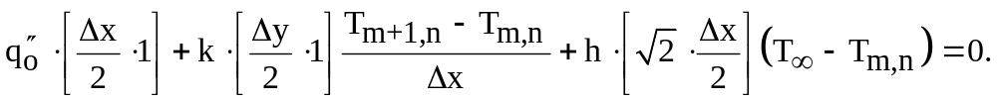
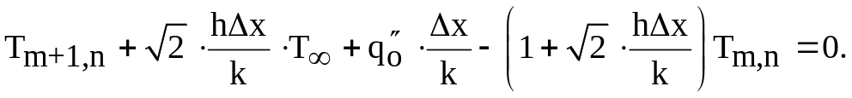
Problem: Finite-Difference Equations (cont.)

Slide 10
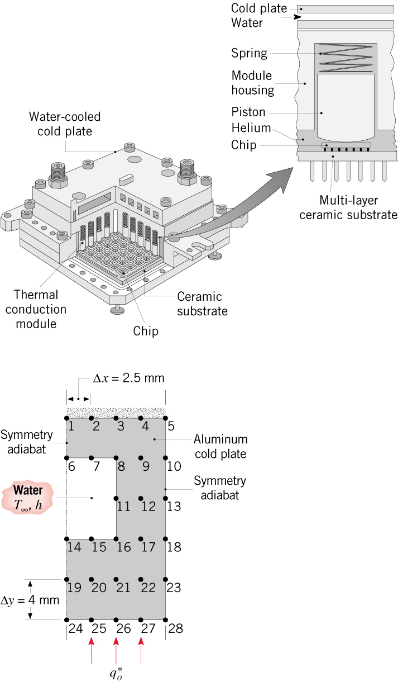

Problem: Cold Plate
Problem 4.78: Analysis of cold plate used to thermally control IBM multi-chip,
thermal conduction module.
Features:
Heat dissipated in the chips is transferred
by conduction through spring-loaded
aluminum pistons to an aluminum cold
plate.
Nominal operating conditions may be
assumed to provide a uniformly
distributed heat flux of
at the base of the cold plate.
Heat is transferred from the cold
plate by water flowing through
channels in the cold plate.
Find: (a) Cold plate temperature distribution
for the prescribed conditions. (b) Options
for operating at larger power levels while
remaining within a maximum cold plate
temperature of 40°C.

Slide 11
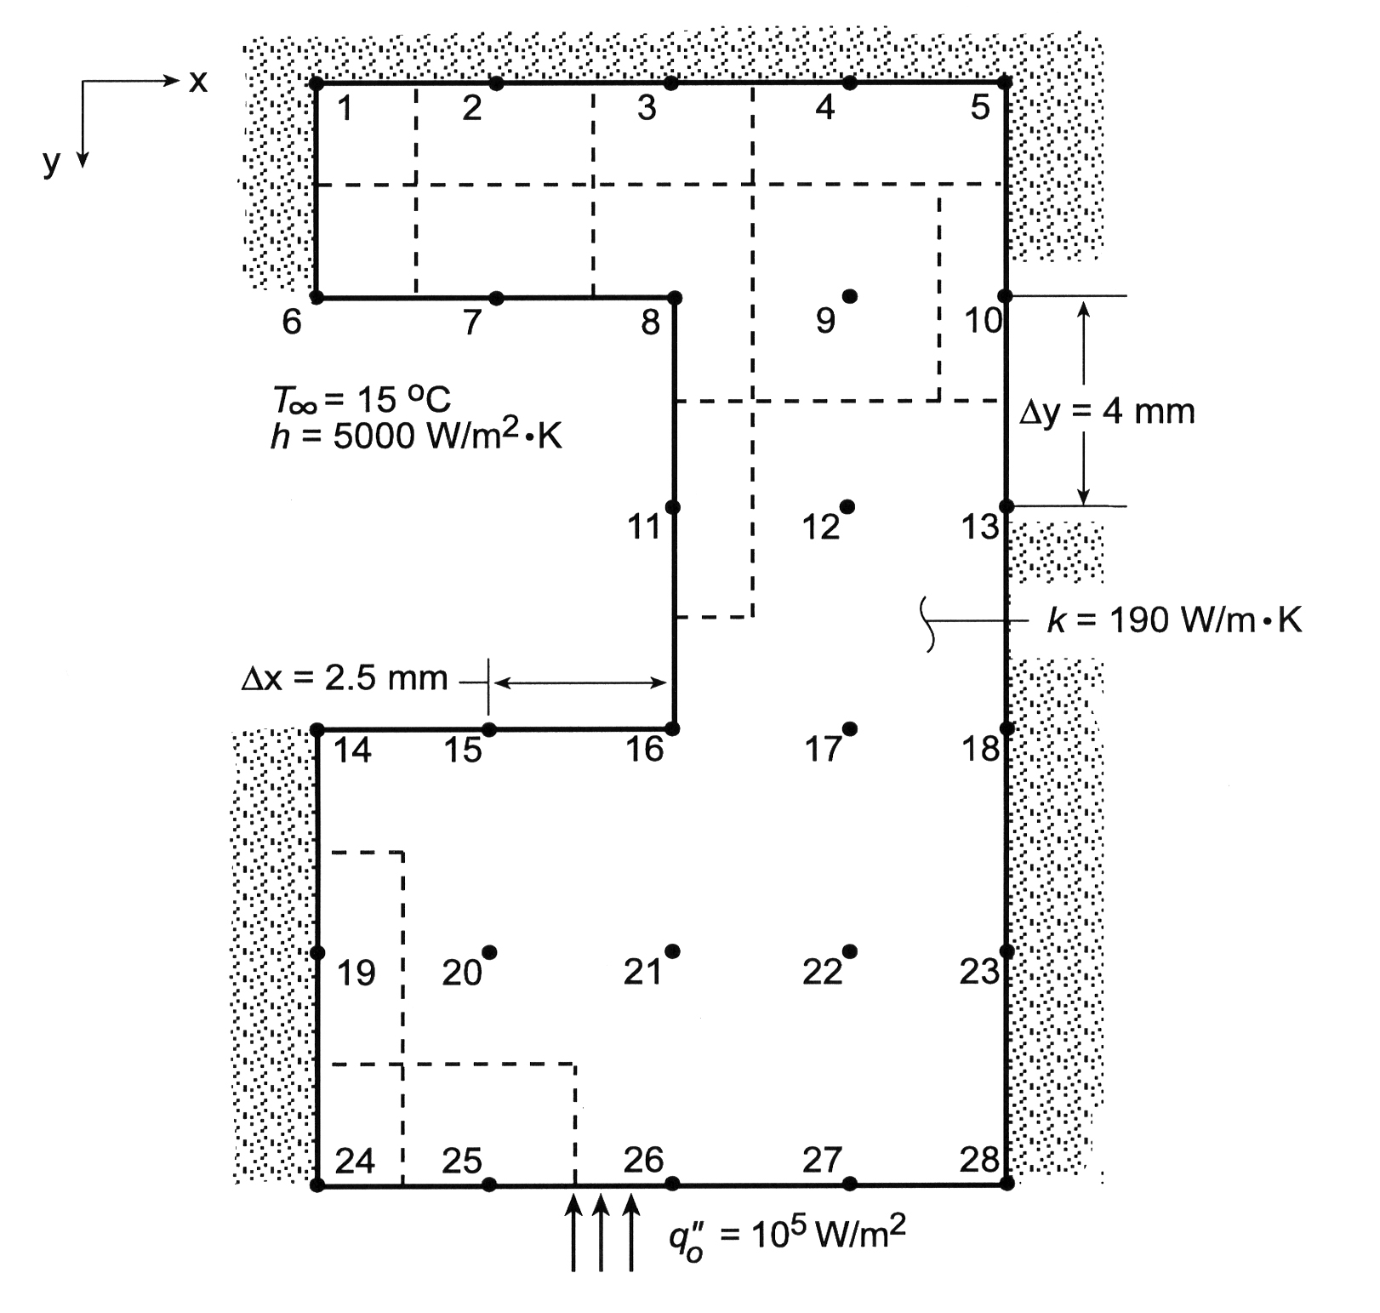
Problem: Cold Plate (cont.)
Schematic:

Slide 12
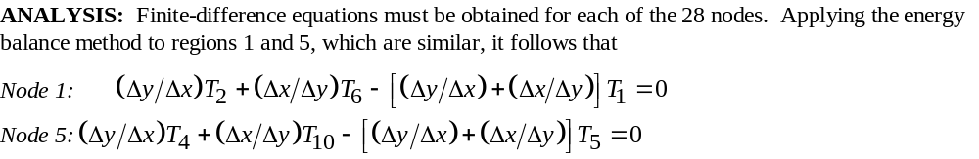
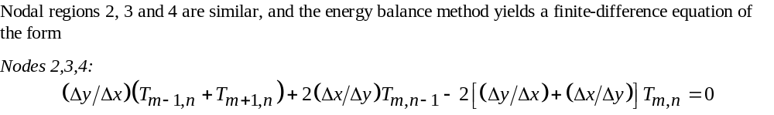
Problem: Cold Plate (cont.)

Slide 13
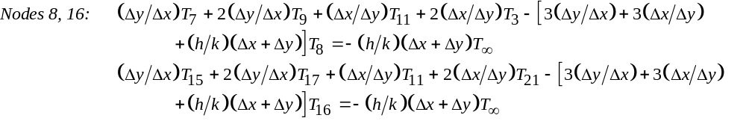
Problem: Cold Plate (cont.)

Slide 14
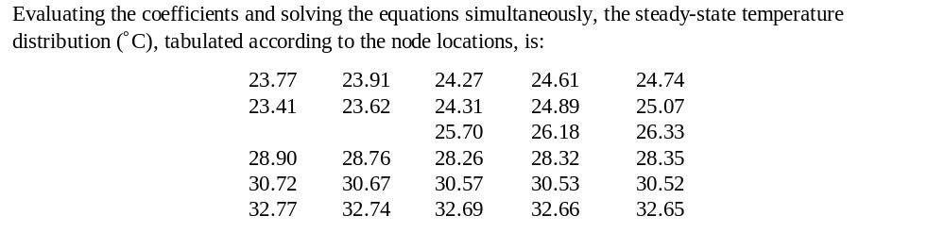
Problem: Cold Plate (cont.)

